Slide 1

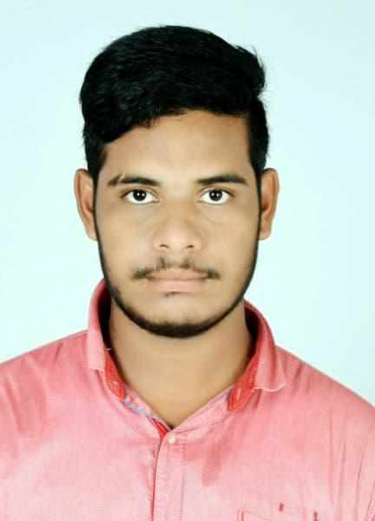
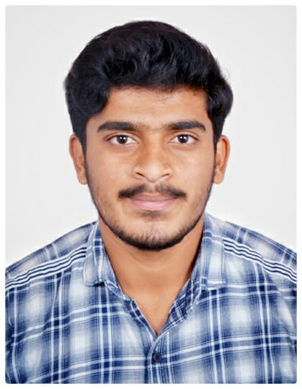



Kartikam Adangi
Education and certificates Bachelor of Technlogy, COMPUTER SCIENCE Engineering : 2016 - 2020
Skills
Analyst/Software Engineer
Base Location: Bangalore
Email ID: Adangi.Kartikam@capgemini.com
Mobile No: +917660900985
Grade: A4
C# | C# Basics,OOPS,Generics, Collections, Array,Loops,LINQ
.NET | Spring Boot, Spring Rest Services, Spring Restful Service
Spring | Components, Hooks, Virtual DOM, Routing, Forms & Validation
Database | Postgre SQL
UI Tech | HTML 5 & CSS, JavaScript,Es6,Bootsrap 4,
Tools | Git & GitHub, Eclipse, STS Postman,swagger,Visual Stu dio, Visual Studio Code, Pg Admin 4, SQL shell.
Add On skills | Immersive Learning and Java
Strengths
Full Stack Developer
Hands on experience on Core java, Postgre SQL, Entity framework, SqlServer, Spring Restful Services.
Proficient in creating Single page Web Application in React with Authentication with routing
Hands on experience in developing web pages using HTML5, CSS, Object TypeScript, Good understanding of Document Object Model (DOM) and DOM Functions
Ready to learn new technologies and implement them for the Future Knowledge improvement.
Achievement
ELECTRONIC-VOTING-SYSTEM
Case study of Electronic-voting-system along with API Gateway, Swagger, responsive UI with HTML5, CSS, Bootstrap and React used as User Interface.
Degreed :Successfully completed the degreed training in git, html, CSS, SQL, React.
Check out my work on GitHub
Presentation Title | Author | Date © Capgemini 2017. All rights reserved | 1

